Slide 1
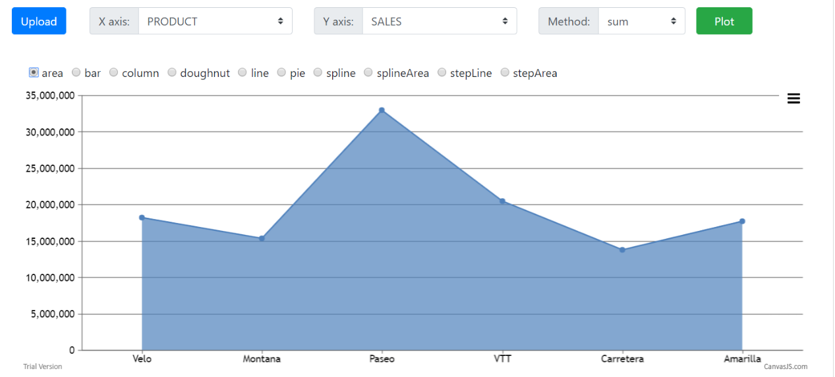
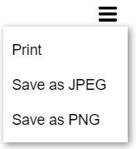
APAC HACKATHON ‘’2018 - UX Data Mining
Team: RDS ROCKERS
Upload File - xlsx
Select Attributes for X and Y axis(Validation present based on data type for x and y axis)
Select graph method
Select graph type
Graph will be plotted for selected axis.
Print/save output
Technology: Spring Boot, Angular 6, Canvas JS, Restful Web services, H2 DB
Scalability: Independent front and back end components and can be easily scalable with the volume if the volume increases (or if required)
Scope of improvements:
User to able to plot output with z axis (3D)
User to be able to select multiple attributes for one axis (both Y and Z)
User to be able to be able to plot detailed graph and breakdown with the help of multiple input files.
Input from multiple file formats
Graph 1

